Slide 1
Telecommunications Security Standards project TESS
Peter Casier
TESS Senior Programme Manager
peter.casier@wfp.org

Slide 2
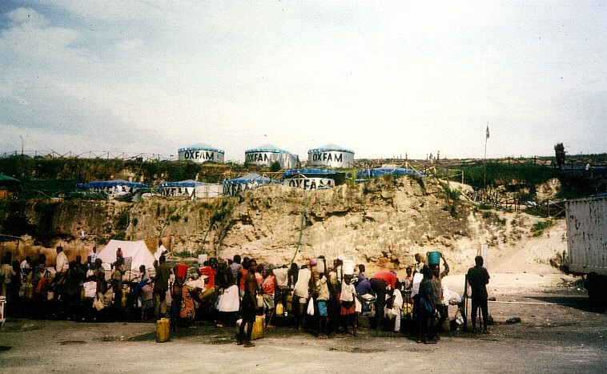
It all started here…

Slide 3
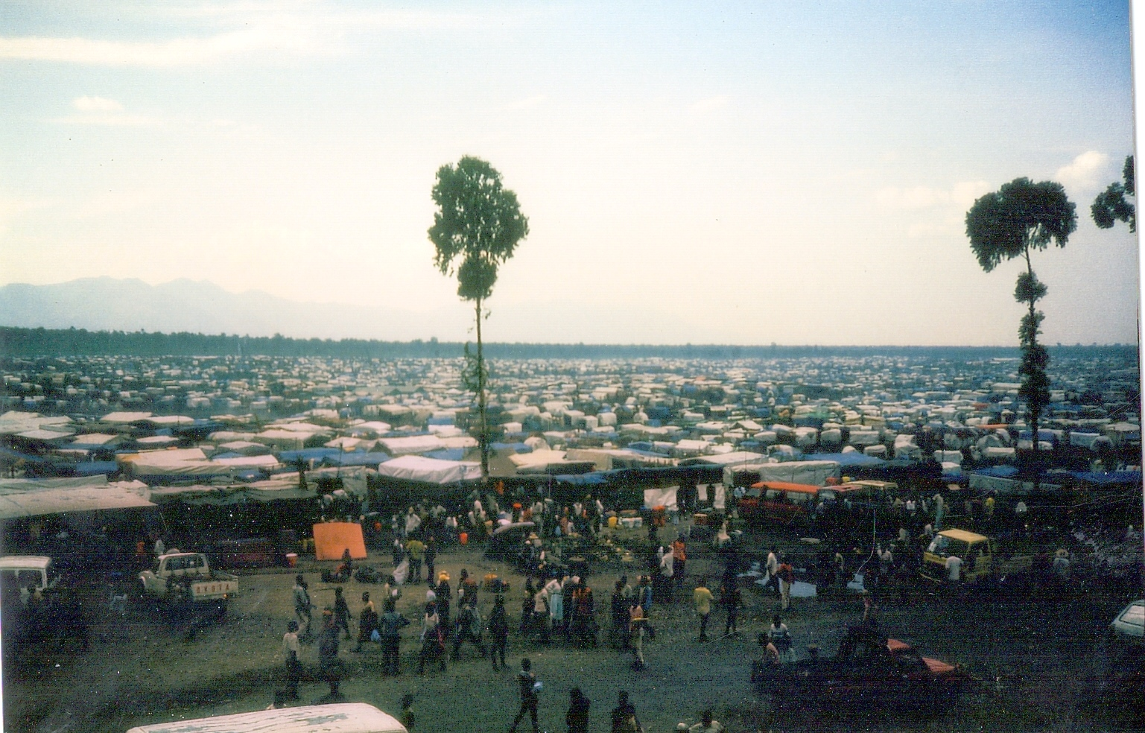
Zaire-Rwanda border (1994-’95)

Slide 4
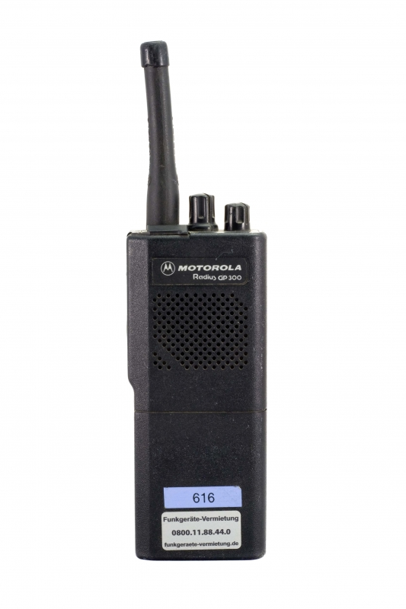
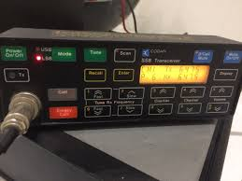
Don’t leave home without these

Slide 5
HF and VHF network design
VHF
Typical network topology
Open RX
TPL
HF
Interstation
HQ
Data

Slide 6
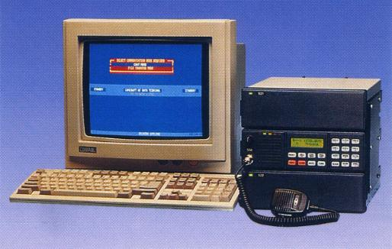
State of the art - data transmission

Slide 7
Kampala (1996-1999)
Frequency standardization
Callsign standardization
HF
VHF
Selcall standardization
Data

Slide 8
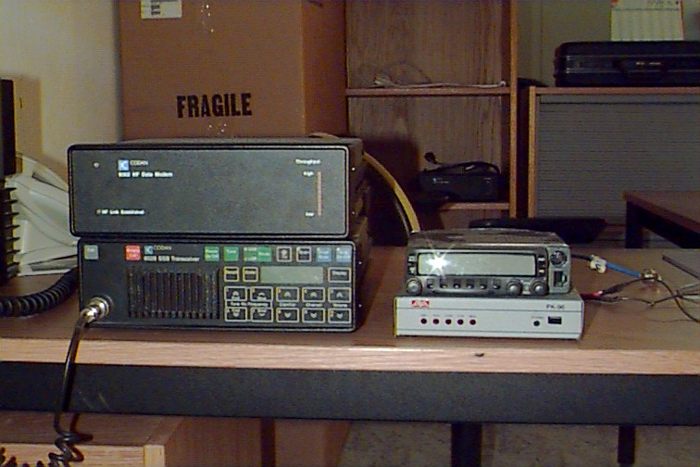
Data

Slide 9
Great Lakes – HF Email Infrastructure

Slide 10
Great Lakes – Email Infrastructure

Slide 11
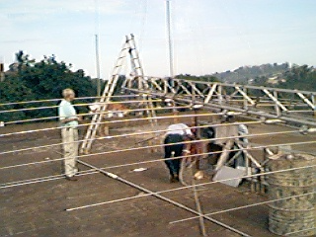
Great Lakes – Physical Infrastructure

Slide 12
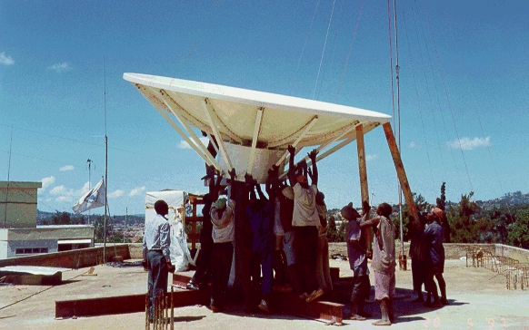
Great Lakes – Physical Infrastructure

Slide 13
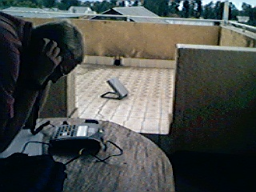
Great Lakes – Physical Infrastructure

Slide 14
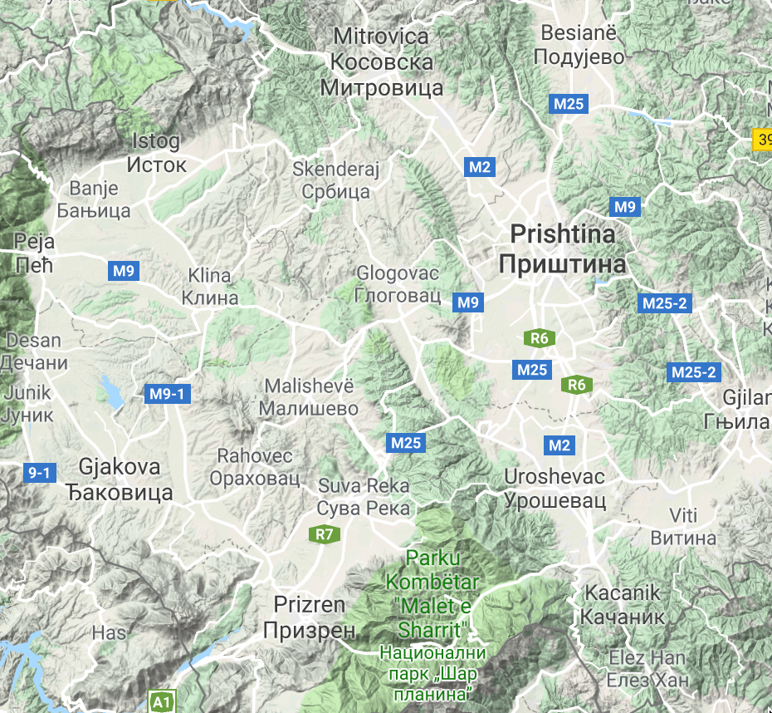
Kosovo 1999

Slide 15
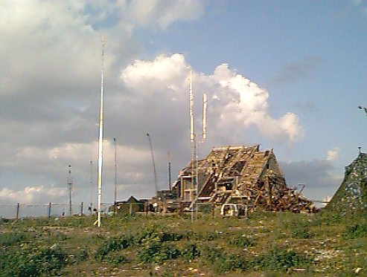
Kosovo 1999…

Slide 16
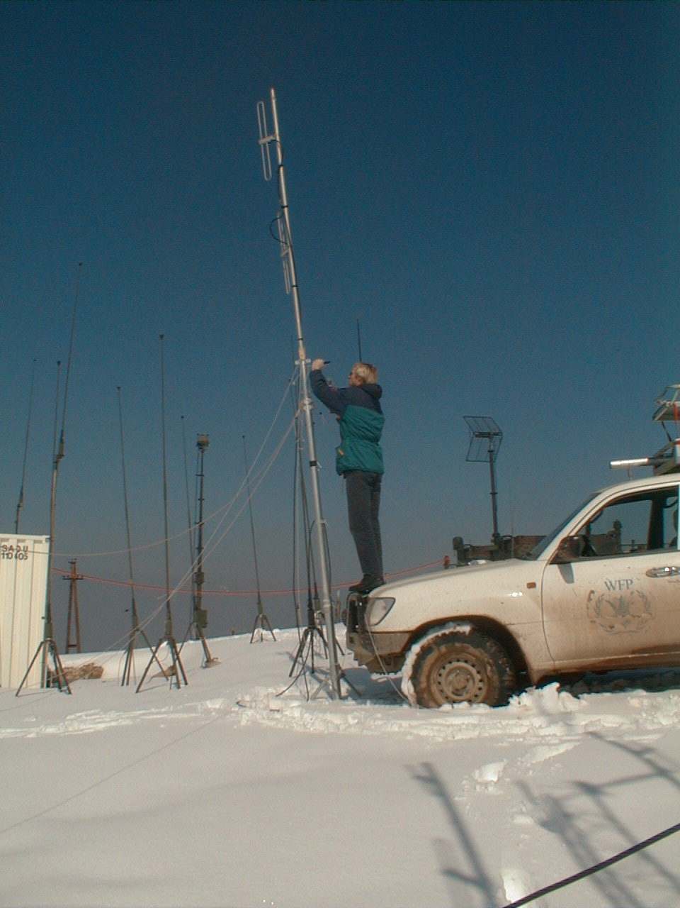
Kosovo 1999…

Slide 17
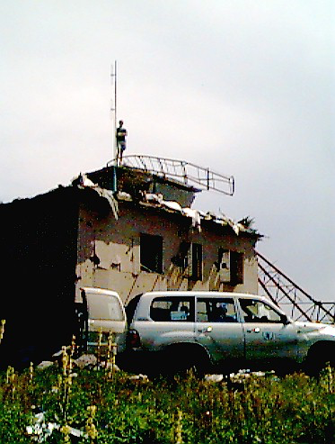
Kosovo 1999…

Slide 18
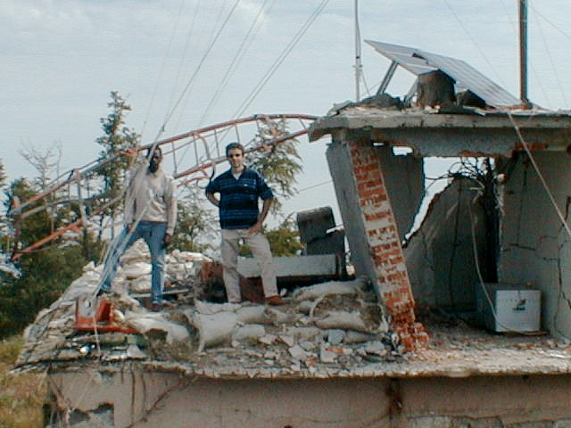
Kosovo 1999…

Slide 19
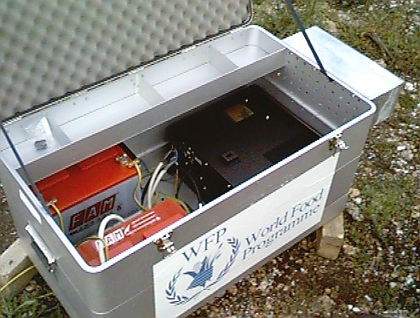
Kosovo 1999…

Slide 20
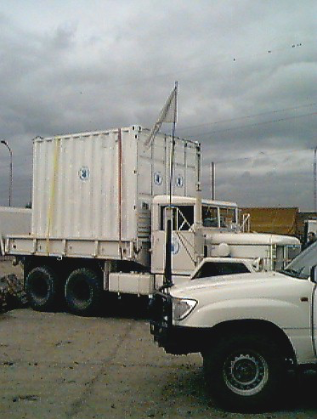
Kosovo 1999…

Slide 21
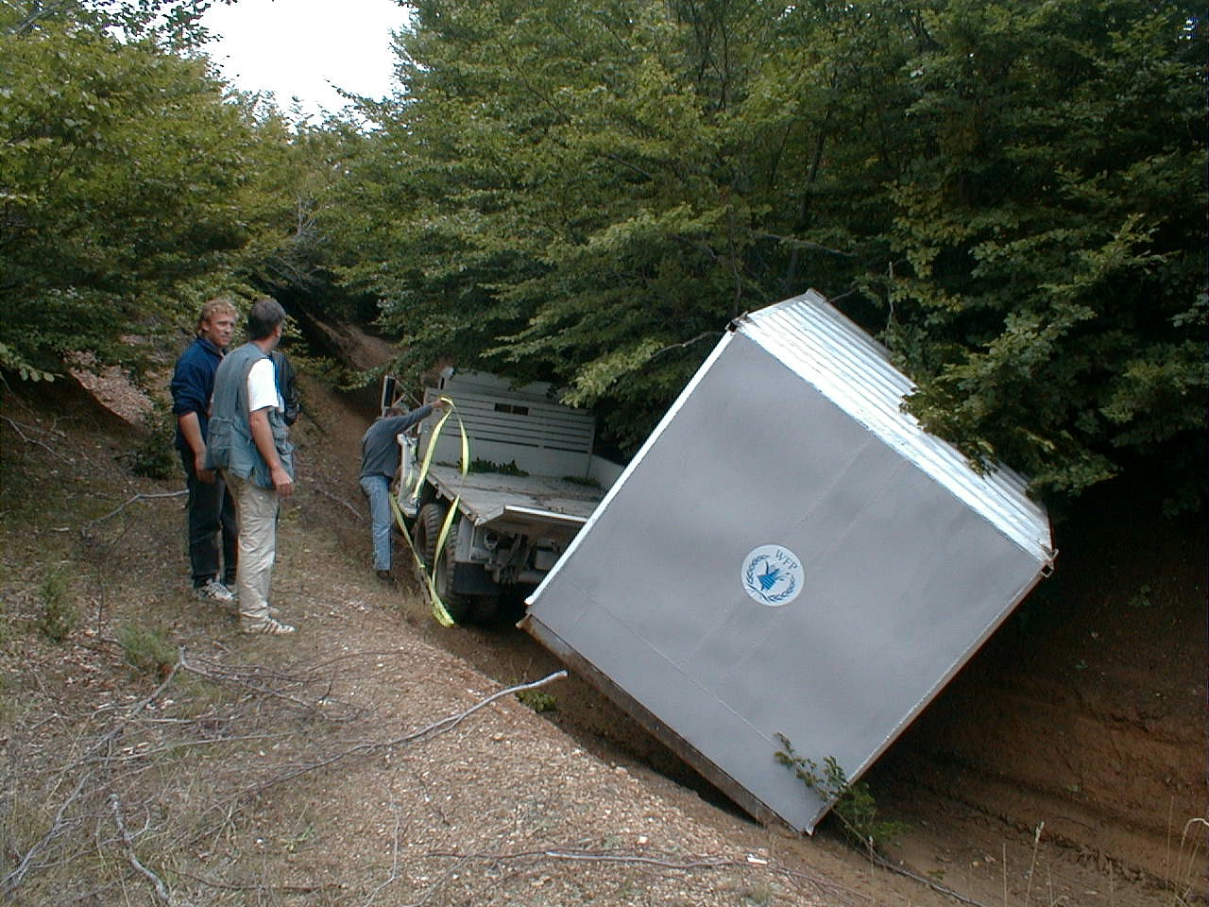
Kosovo 1999…

Slide 22
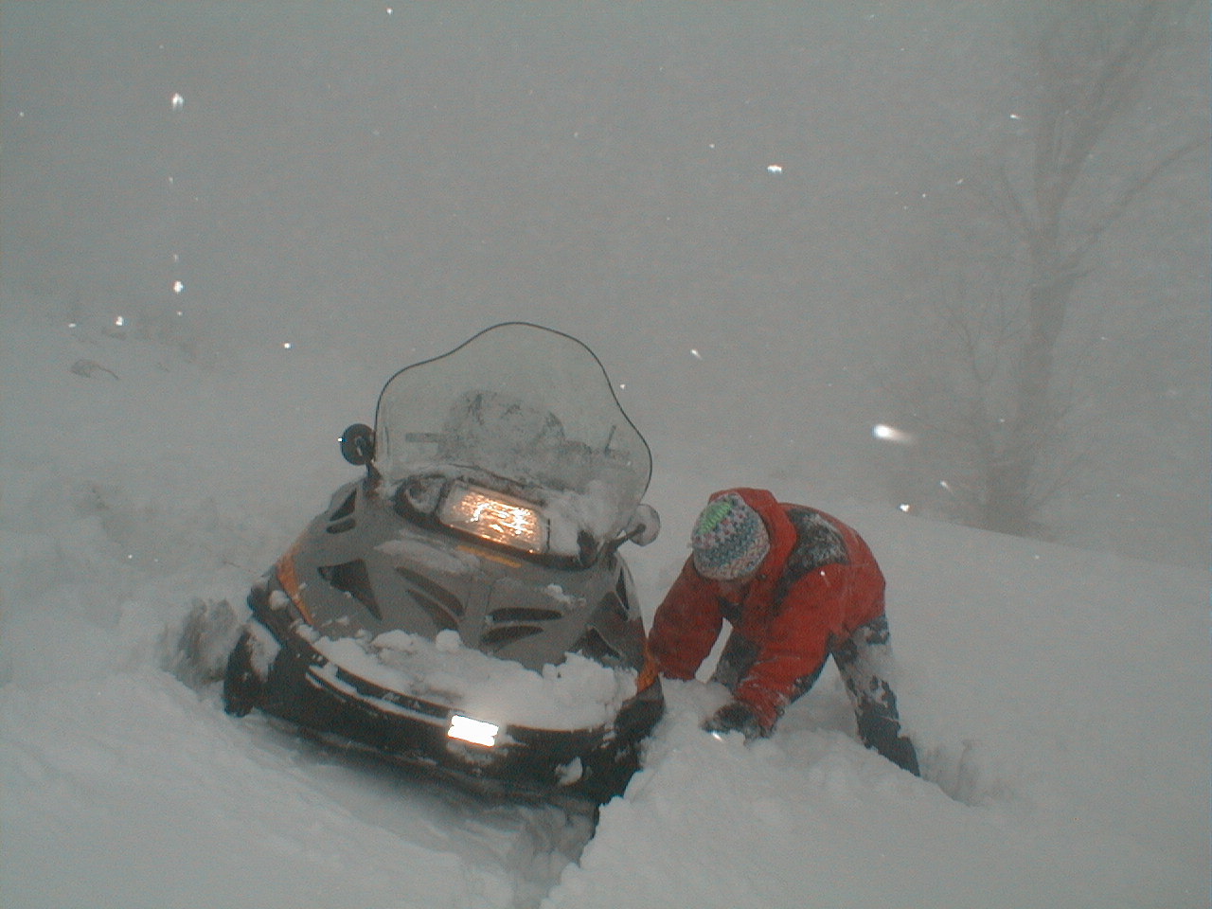
Kosovo 1999…

Slide 23
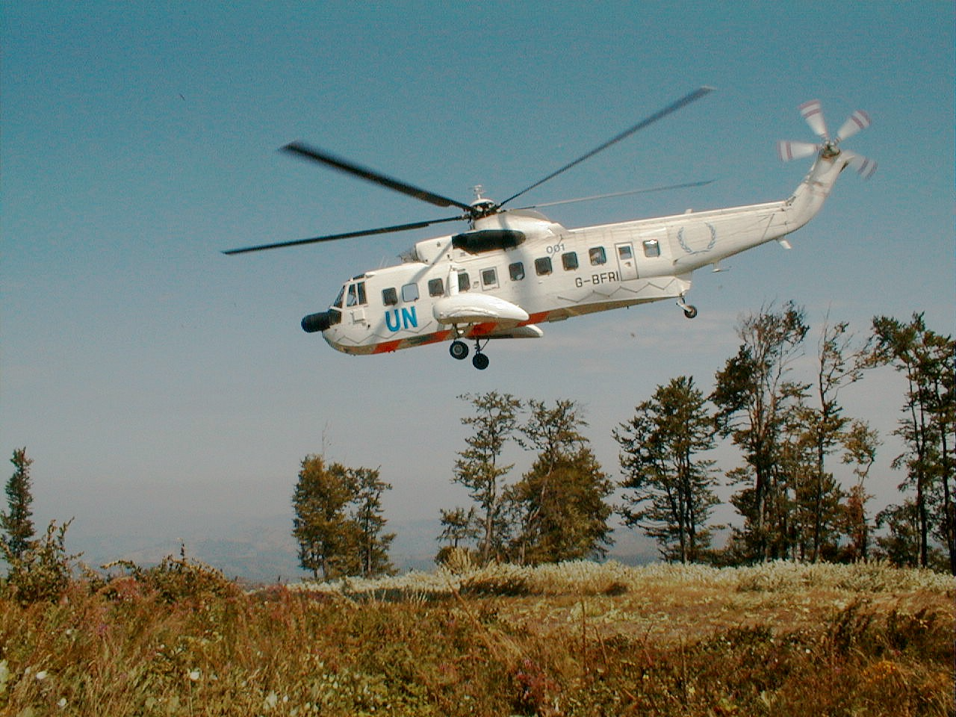
Kosovo 1999…

Slide 24
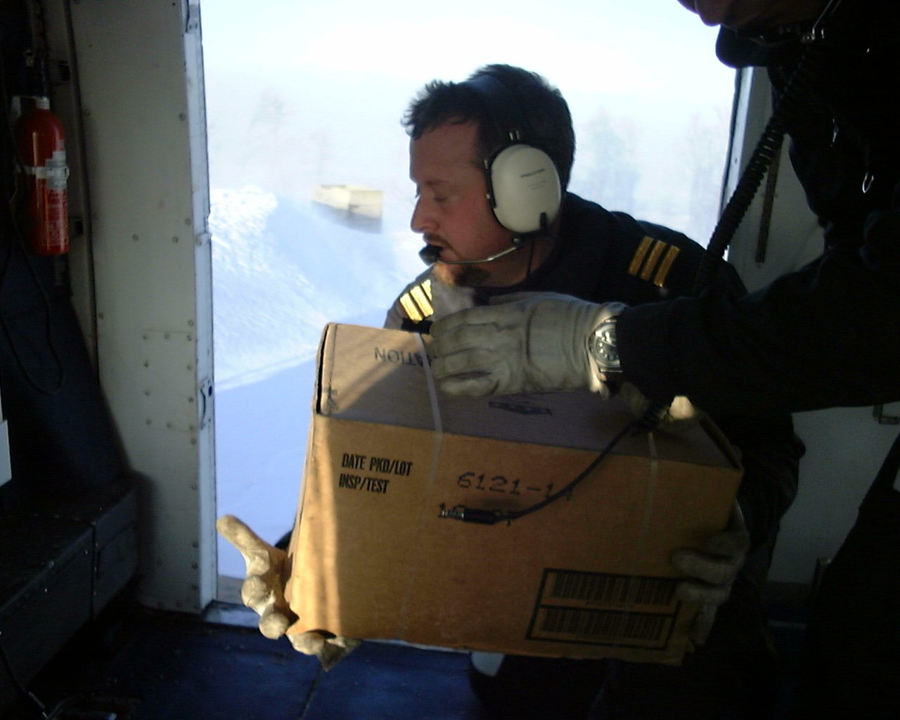
Kosovo 1999…

Slide 25
Security standards (1998-2004)
VHF SelV signaling
Callsign display
Selective call
Call-all
Panic Button
Remote stunning
Lone worker
HF Selective Callsign extension (6 digits)
MiniM portable satellite
Gradual introduction handheld satellite / Vsat

Slide 26
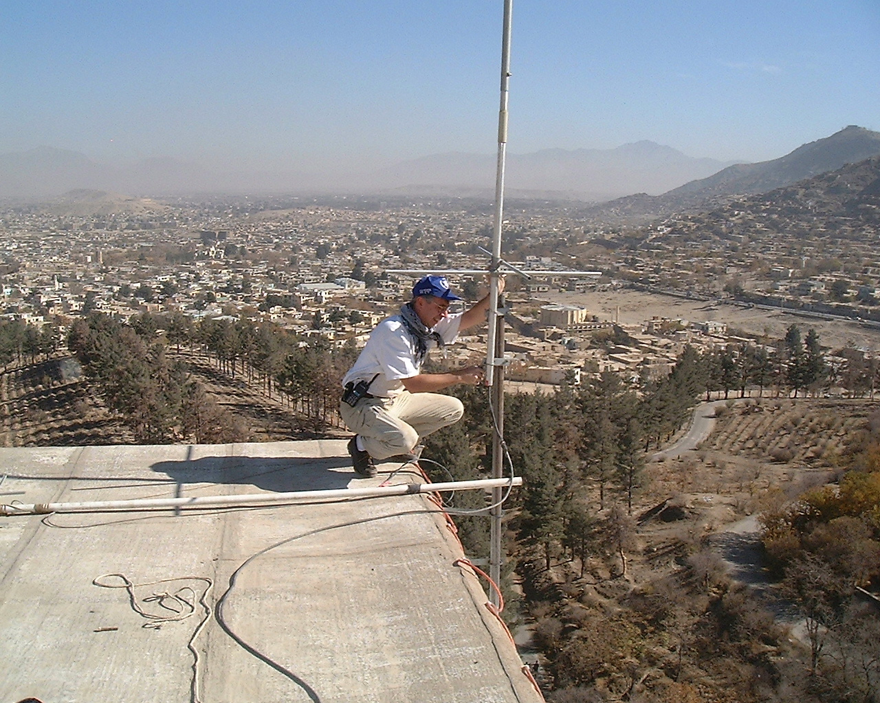
Afghanistan 2001-2002

Slide 27
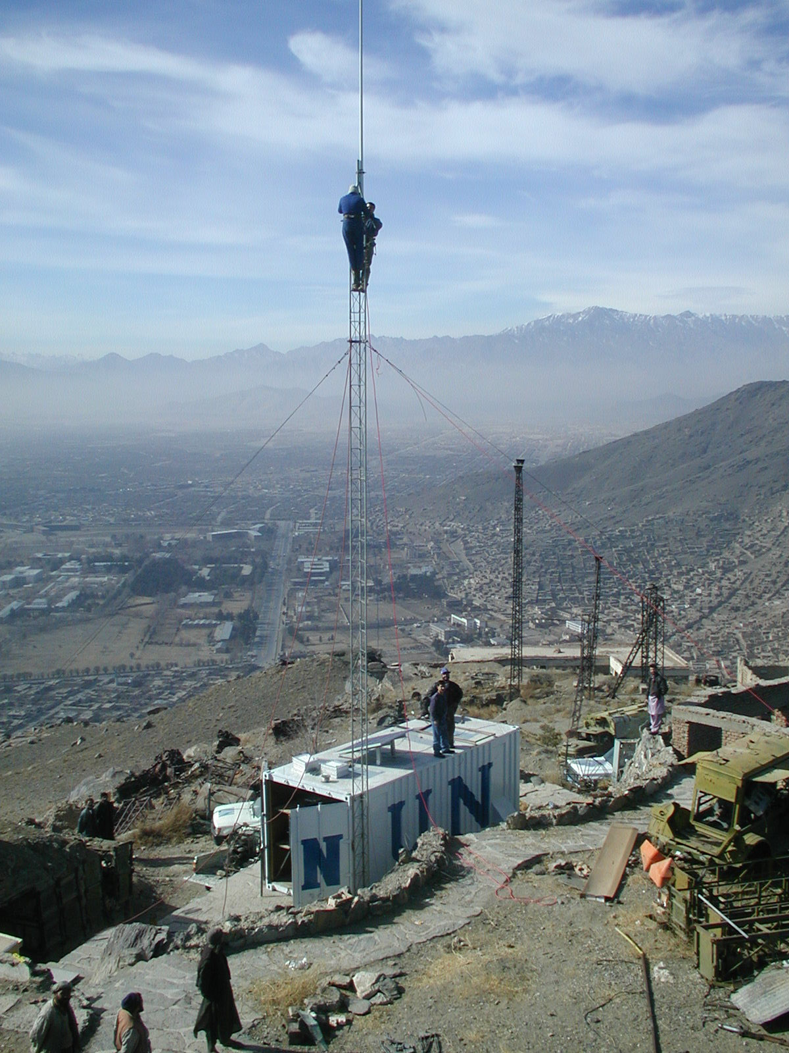
Afghanistan 2001-2002

Slide 28
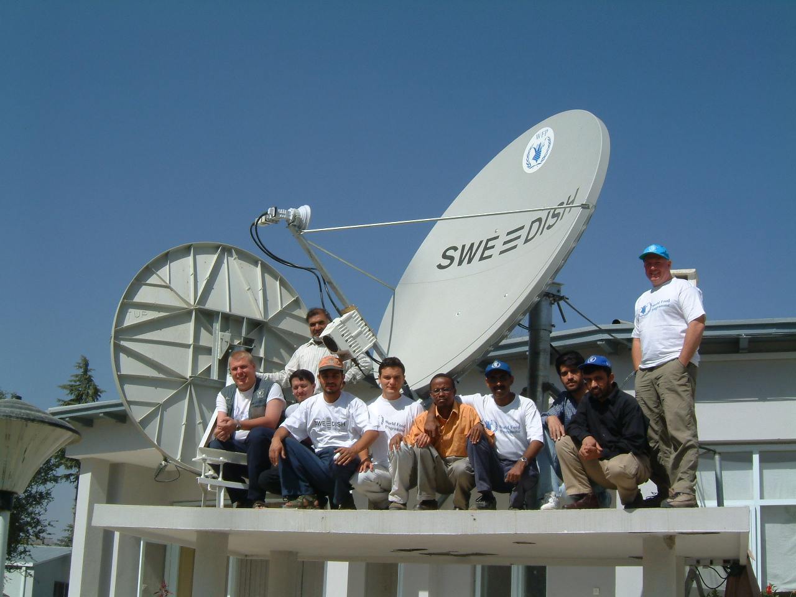
Afghanistan 2001-2002

Slide 29
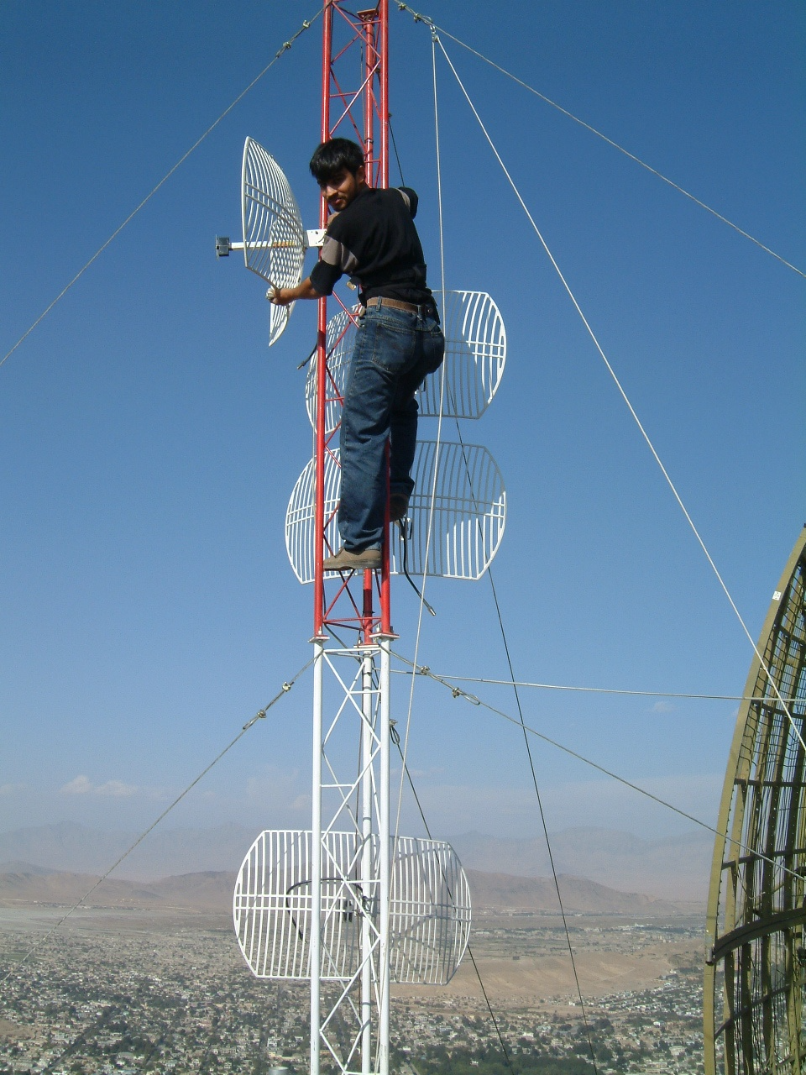

Slide 30
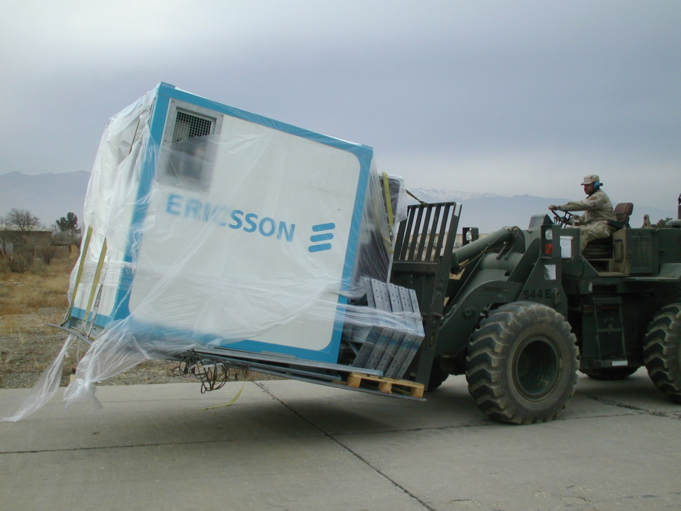

Slide 31
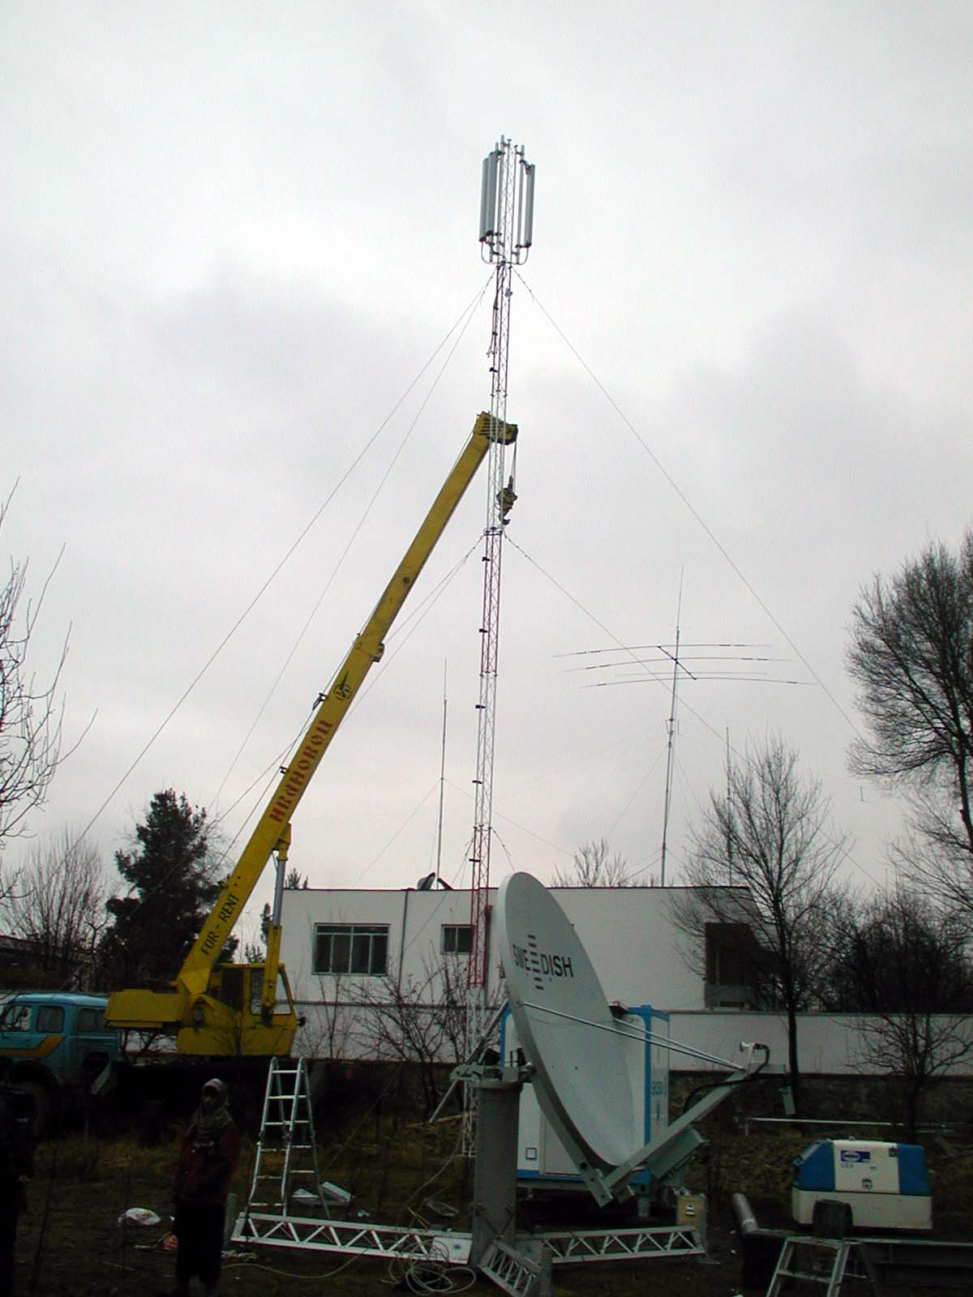

Slide 32
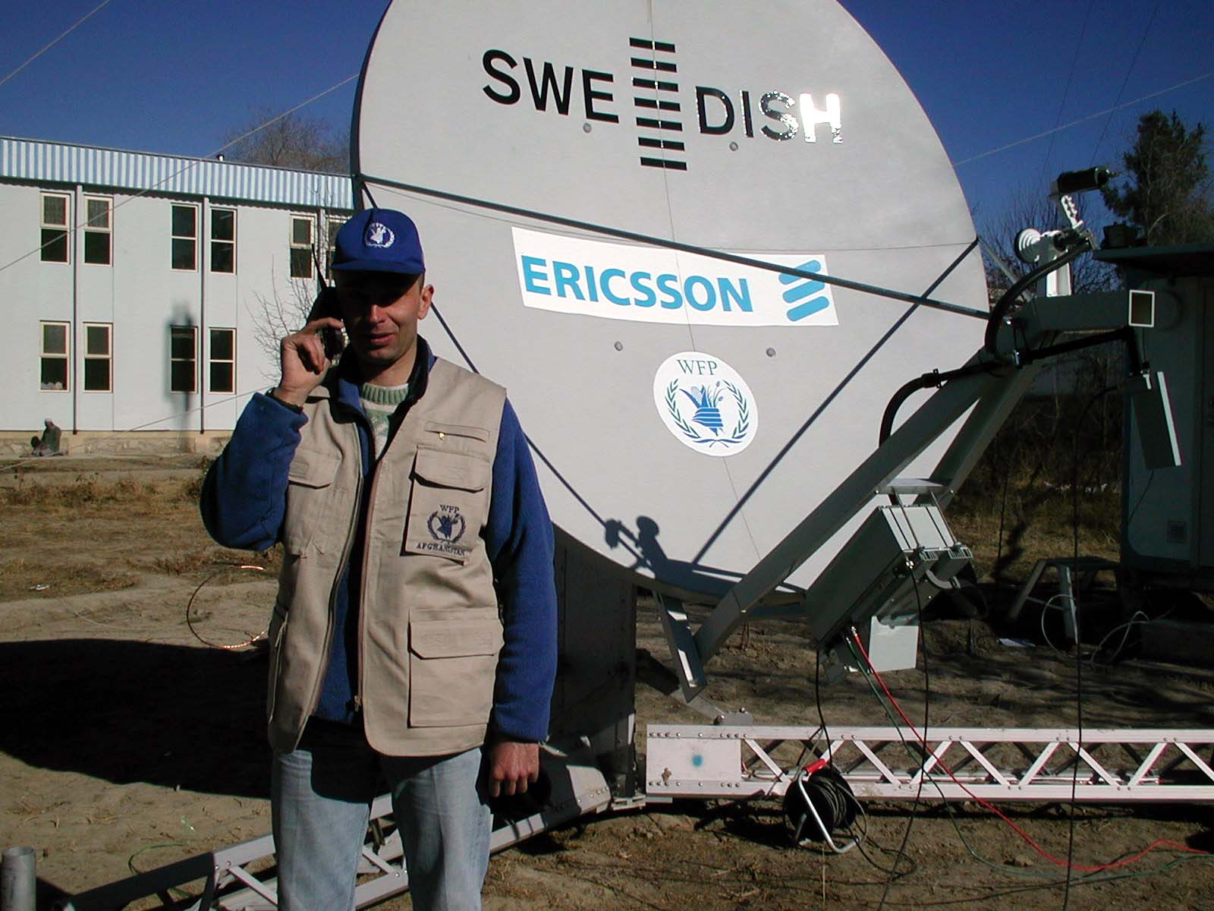

Slide 33
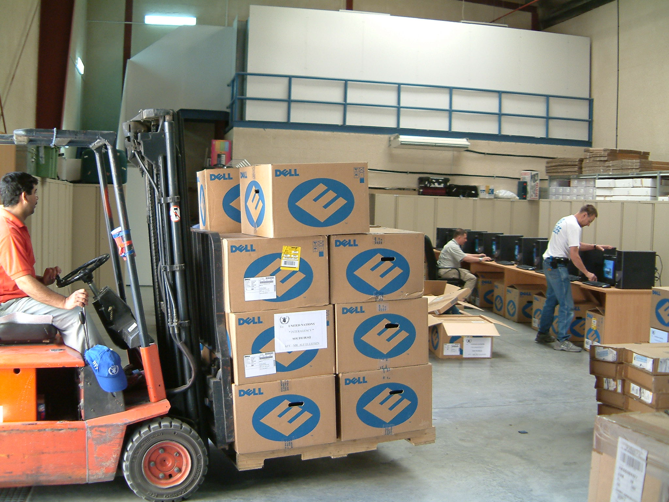
Iraq 2003

Slide 34
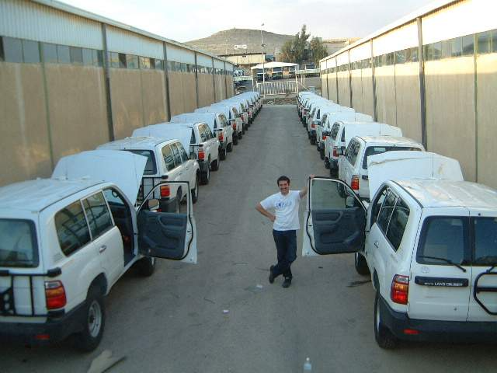

Slide 35
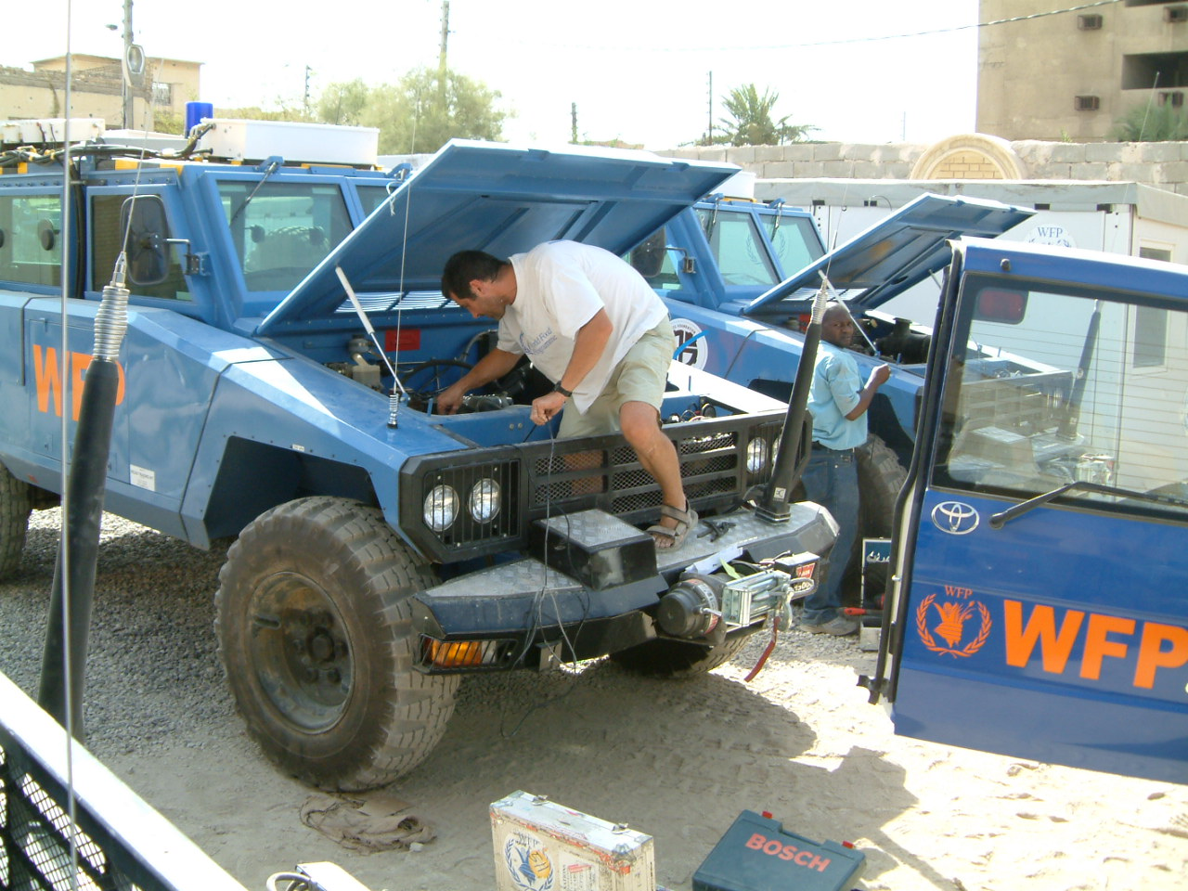

Slide 36
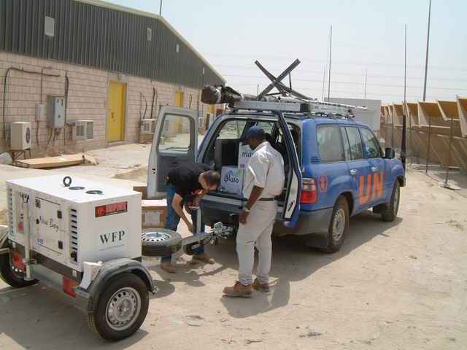

Slide 37
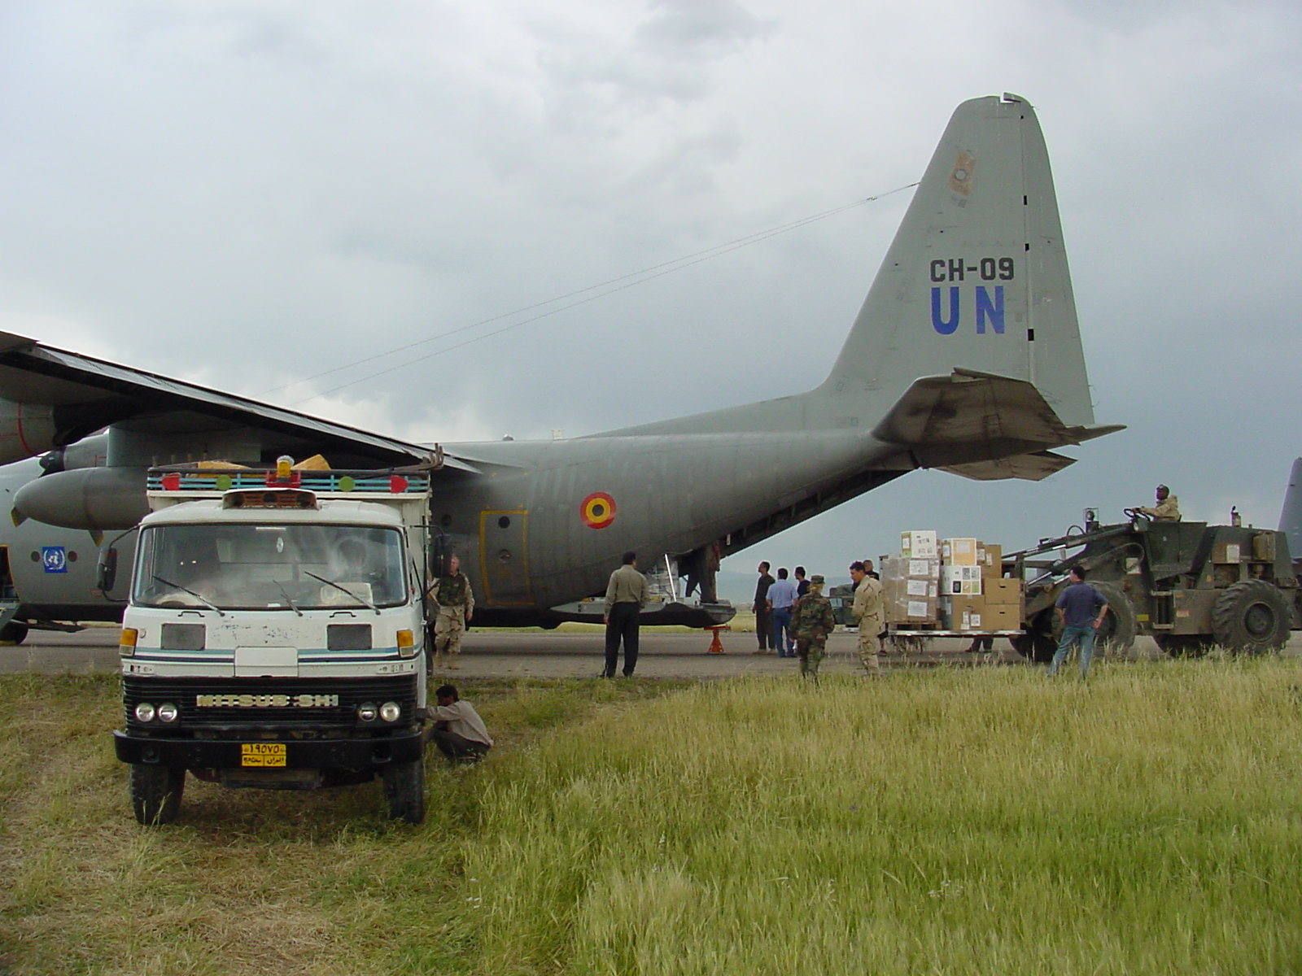

Slide 38
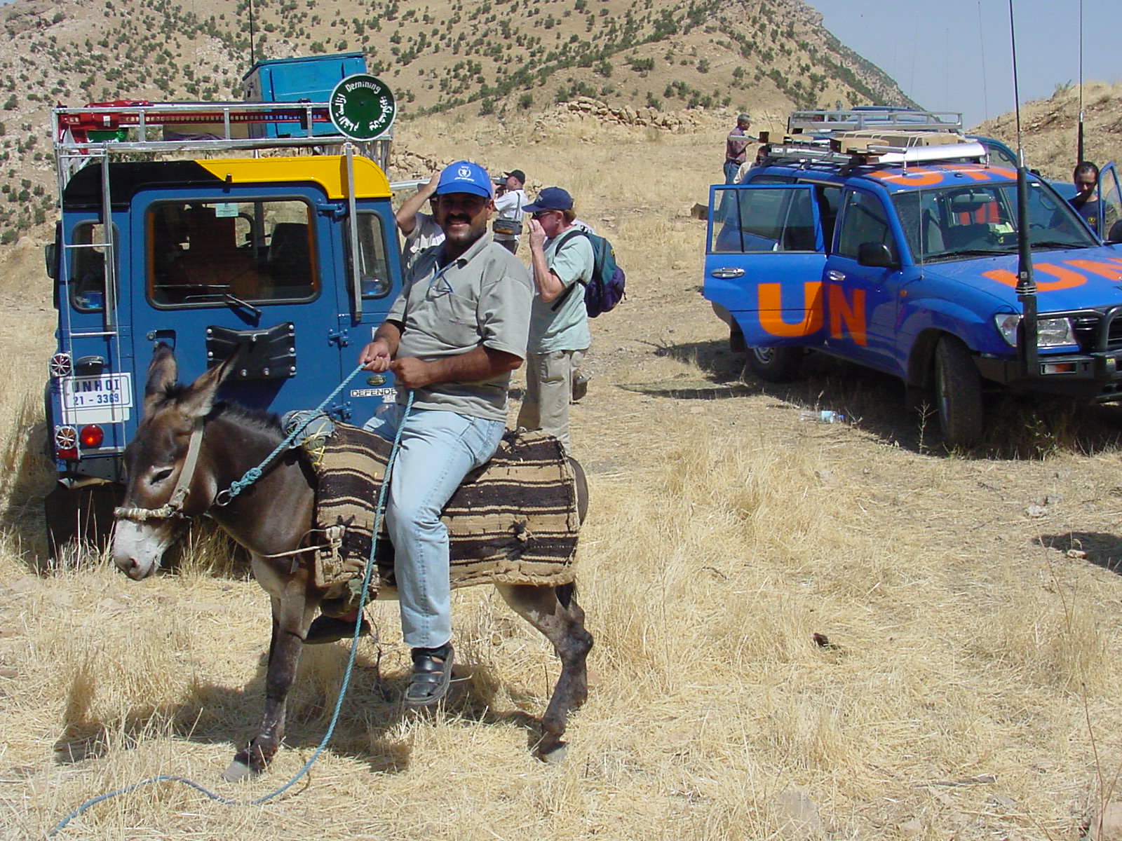

Slide 39
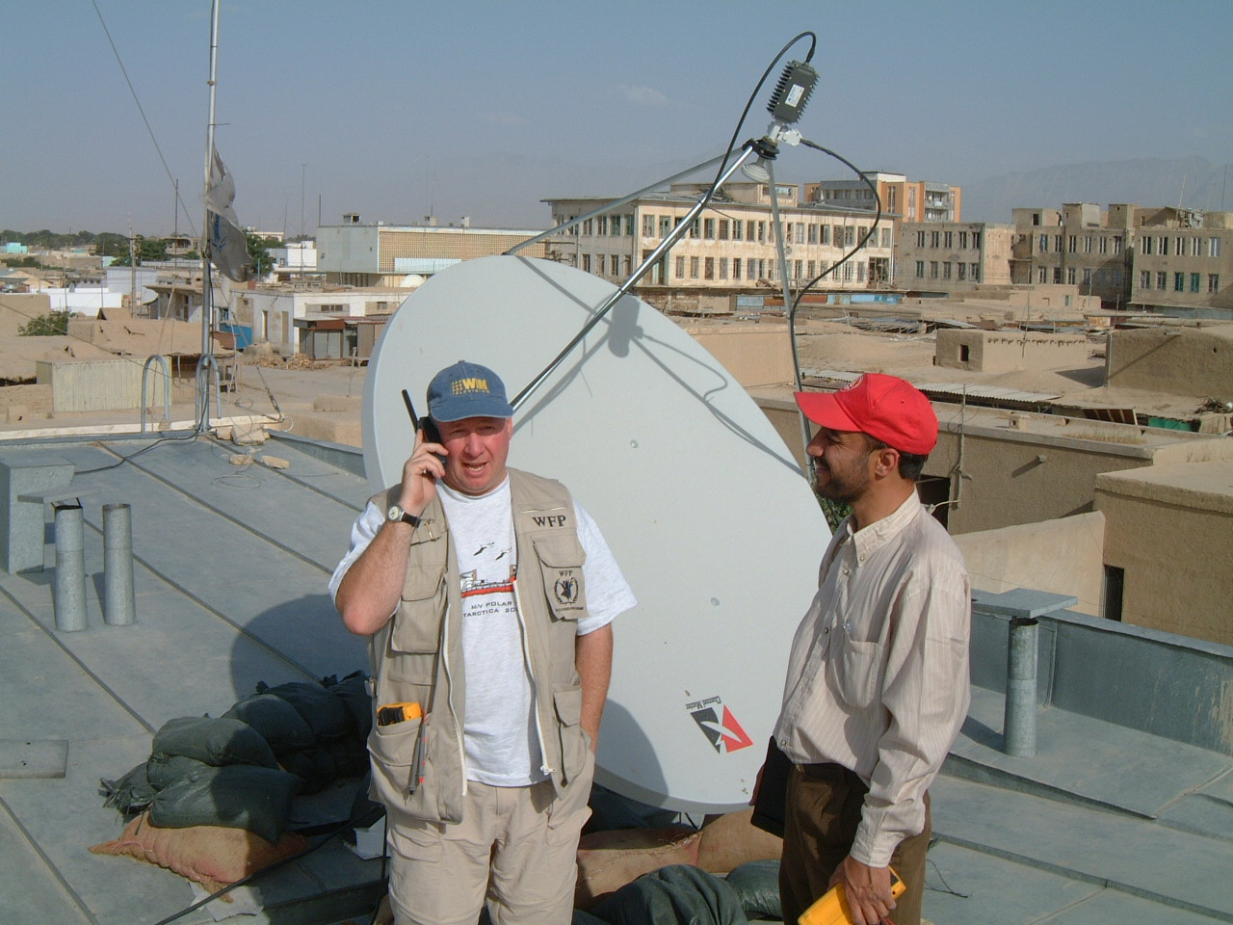

Slide 40
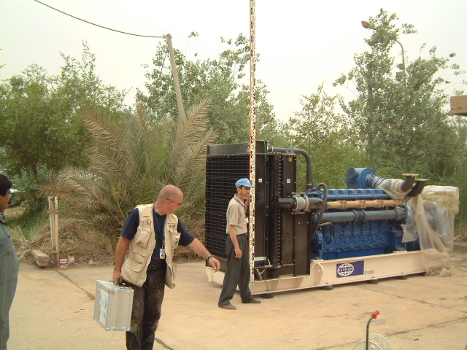

Slide 41
TESS
UN & NGO Telecommunications Security Standards:
Any staff, anywhere in the operational area, should be contactable by the comms center, or be able to contact the comms center.
Notes:
Purpose within the UN context: clear recommendations on the standardizations of future UN security telecommunications systems (connectivity, applications and procedures), and to inform UNSMS decision-makers and stakeholders so they can streamline their field investments for future security telecommunications services.
Project clients: UN agencies (UNSMS w/UNDSS and IASMN as main stakeholders) and the NGO community (through ETC)
So what I present to you, and what we work on with you, is only one side of TESS, the UN side, but we work also with the NGO community, via the emergency telecoms cluster, to provide guidance and standards for the wider humanitarian community
Core project team: currently one full time programme manager (funded by WFP), two part-time soon to be full time technical staff (provided and funded by WFP), all finance/admin/logistics/project supervision is done by WFP, and soon a WFP security officer will join us on TDY, and we take on 2 more senior technical staff who can take over the assessment missions from me, and we are hiring a working group facilitator. All WFP funded.
4 functional reporting lines.
A clear but also well defined mandate, given by UNDSS: ‘TESS’, will make clear recommendations on the standardizations of future UN security telecommunications systems (connectivity, applications and procedures), and to inform UNSMS decision-makers and stakeholders so they can streamline their field investments for future security telecommunications services.
At the same time we are to provide to Designated Officials and field security personnel hands-on advice on issues such as assessing local GSM systems on their suitability as security telecommunications channels, re-assessing currently used systems, or comparing different technical solutions in functionality, cost and risks.
The project’s final aim will be a new security telecommunications business model that is approved and supported by all inter-agency stakeholders and UNDSS. The project is a collaborate effort between UN agencies, NGOs, technical/operational/security specialists and the private sector.

Slide 42
What is TESS?
Purpose
Project Clients
Project Team
Functional reporting lines:
Chair of IASMN TAG
Chair of ETC
WFP ICT (Chief TECF)
WFP Security (RMQ)
Mandated by UNDSS
Notes:
Purpose within the UN context: clear recommendations on the standardizations of future UN security telecommunications systems (connectivity, applications and procedures), and to inform UNSMS decision-makers and stakeholders so they can streamline their field investments for future security telecommunications services.
Project clients: UN agencies (UNSMS w/UNDSS and IASMN as main stakeholders) and the NGO community (through ETC)
So what I present to you, and what we work on with you, is only one side of TESS, the UN side, but we work also with the NGO community, via the emergency telecoms cluster, to provide guidance and standards for the wider humanitarian community
Core project team: currently one full time programme manager (funded by WFP), two part-time soon to be full time technical staff (provided and funded by WFP), all finance/admin/logistics/project supervision is done by WFP, and soon a WFP security officer will join us on TDY, and we take on 2 more senior technical staff who can take over the assessment missions from me, and we are hiring a working group facilitator. All WFP funded.
4 functional reporting lines.
A clear but also well defined mandate, given by UNDSS: ‘TESS’, will make clear recommendations on the standardizations of future UN security telecommunications systems (connectivity, applications and procedures), and to inform UNSMS decision-makers and stakeholders so they can streamline their field investments for future security telecommunications services.
At the same time we are to provide to Designated Officials and field security personnel hands-on advice on issues such as assessing local GSM systems on their suitability as security telecommunications channels, re-assessing currently used systems, or comparing different technical solutions in functionality, cost and risks.
The project’s final aim will be a new security telecommunications business model that is approved and supported by all inter-agency stakeholders and UNDSS. The project is a collaborate effort between UN agencies, NGOs, technical/operational/security specialists and the private sector.

Slide 43
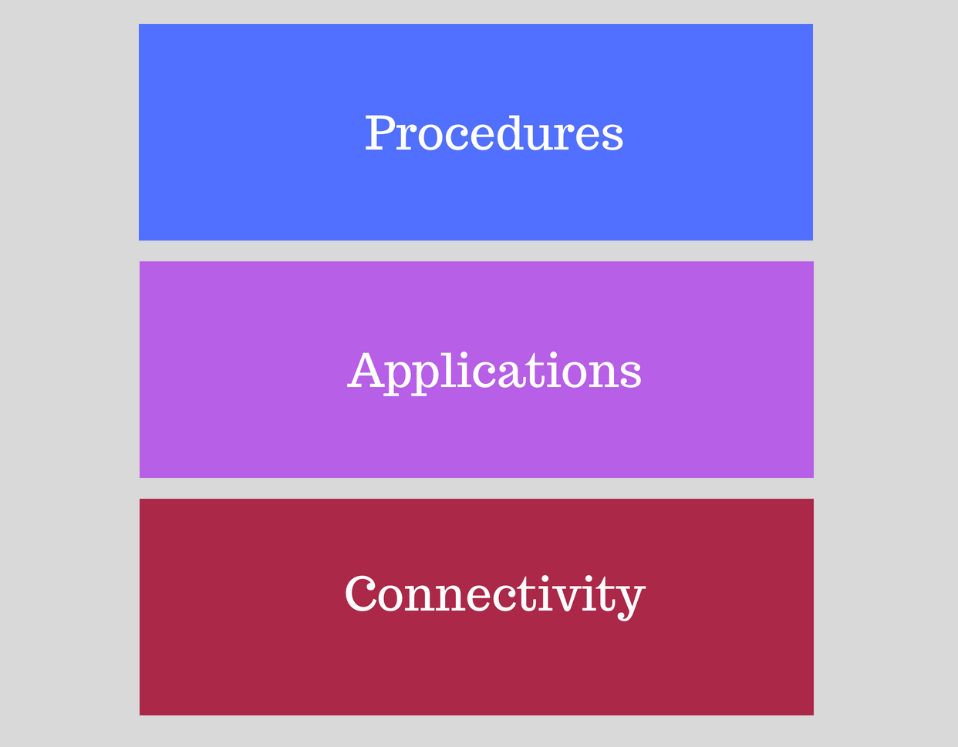
TESS: Three Layers

Slide 44
TESS: Three Project Streams
Stream 1: Active support to field missions
Stream 2: Standardize “what is currently used”
Stream 3: Longer term standards

Slide 45
TESS: Stream 1 progress
Onsite full assessments: RSA, Burkina Faso, Mauritania, Senegal, Guinea Bissau, Bangladesh, NE Nigeria, South Yemen, Iraq, Sudan
Onsite technical support/assessment: Bangladesh, Nepal, Malawi
Remote support: Syria, Kazakhstan, Cambodia, Ethiopia, Bolivia, Somalia, Tanzania, Zambia, Ghana, eSwatini, Lesotho, Gambia, Burundi, Algeria, Togo,..
Planned full assessments missions (up to Jan 2019): DRC
Planned technical support missions (up to Jan 2019): Gambia, Cox’s Bazar
Expansion of technical support and assessment team (incl. interagency staff)
Current: +- 30 TESS Focus countries
Includes DRO support and follow-up

Slide 46
TESS: Stream 2 progress
VHF Working Group
Overall VHF standard architecture is designed
January: start of MSS (Mobile Satellite Systems) Working Group
March: start of vehicle tracking Working Group
Target: June 2019
TOR: Standards (3 TESS layers), support further process design (manuals, training, input for LTA tender, technical support)

Slide 47
TESS: Stream 3 progress
May 2019: overall Stream 3 project plan

Slide 48
Where are we going?
Mobile phone network
First choice
Applications
Backup (or exceptional) prime network: VHF
New architecture
On body:
Mobile phone
Portable satellite (Iridium, Thuray)
Satellite PTT ?
Mini Portable satellite (Iridium Go)

Slide 49
Where are we going?
Base:
More reliance on data
Optimized radio operations
Optimized vehicle and staff tracking
Less HF
Vehicles
Automated tracking
Satellite comms
Less HF (sniff….)

Slide 50
Where are we going?

